Slide 2
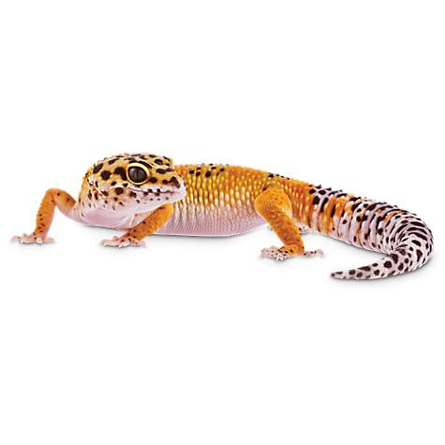
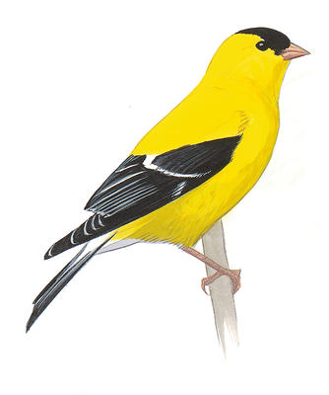
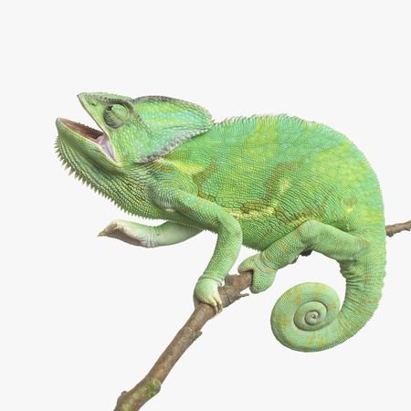
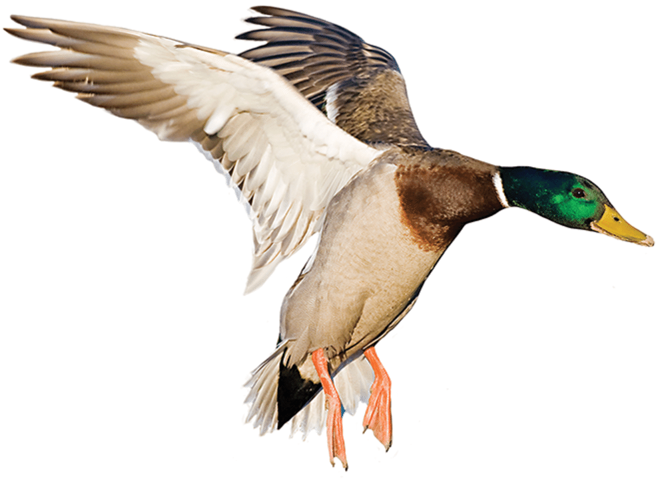
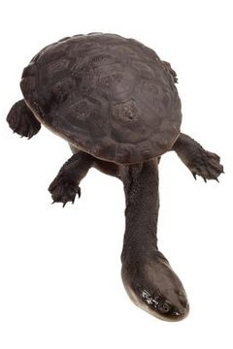
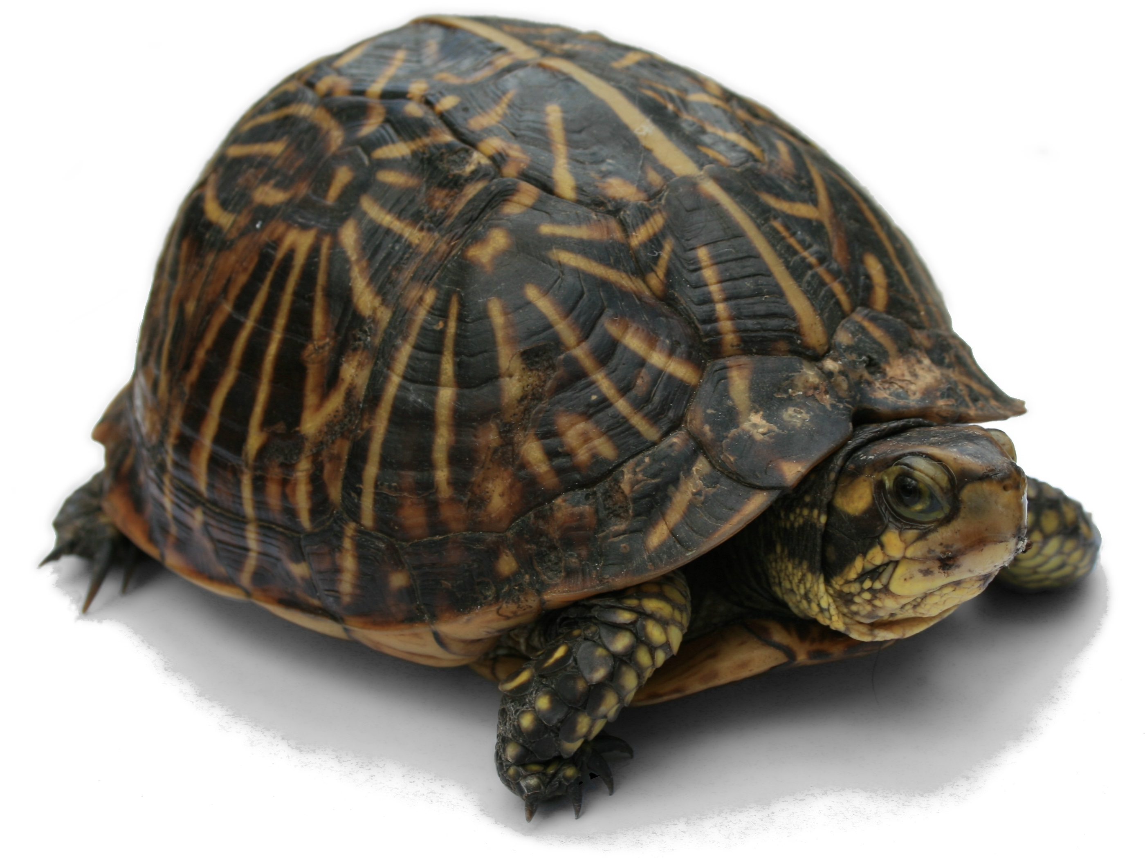
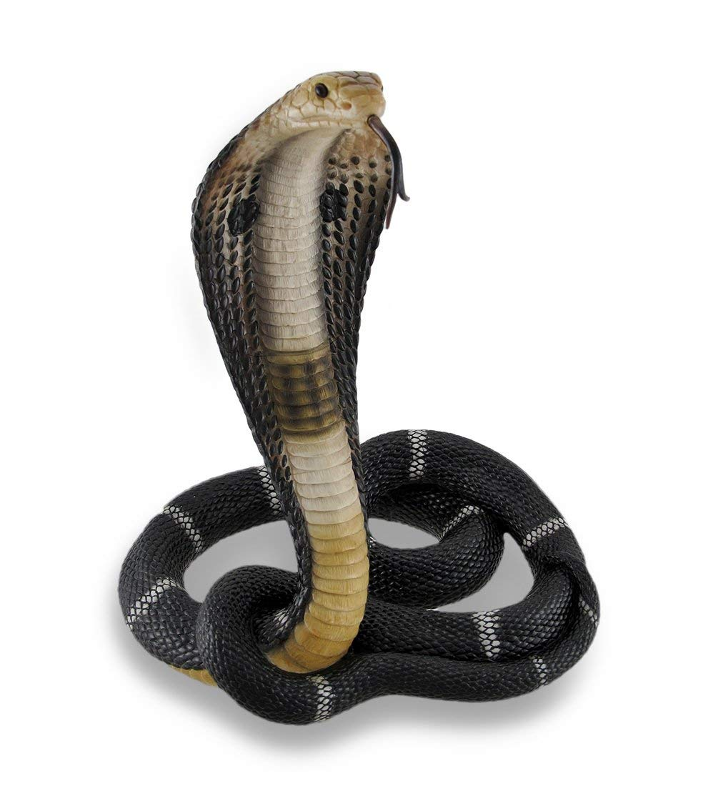
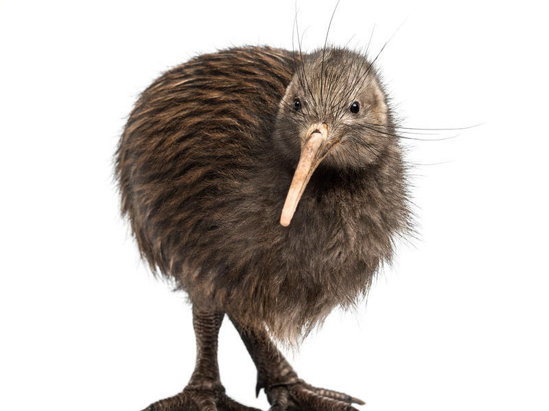
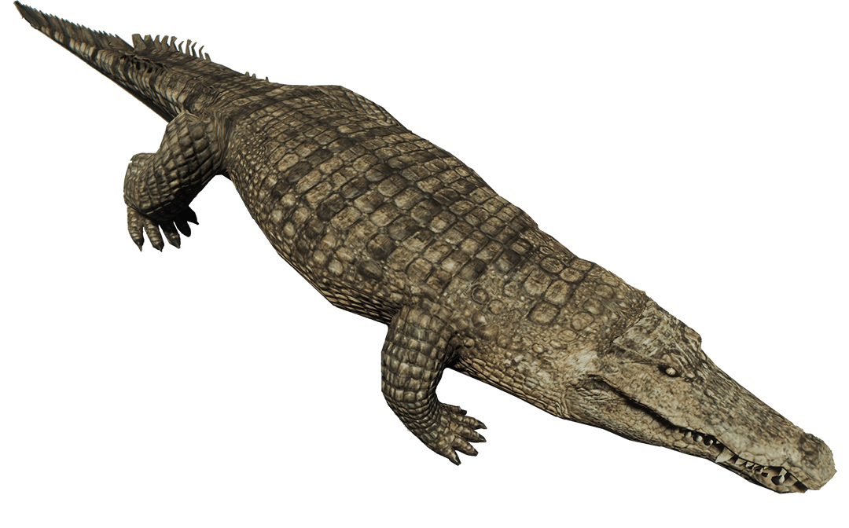
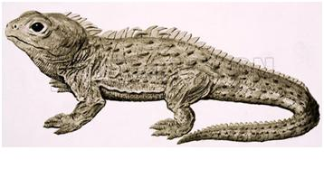
Diapsida

Slide 3
Diapsida
Lepidosauria
Archosauria
Testudines

Slide 4
Diapsida
Lepidosauria
Archosauria
Testudines
Aves
Squamata

Slide 5
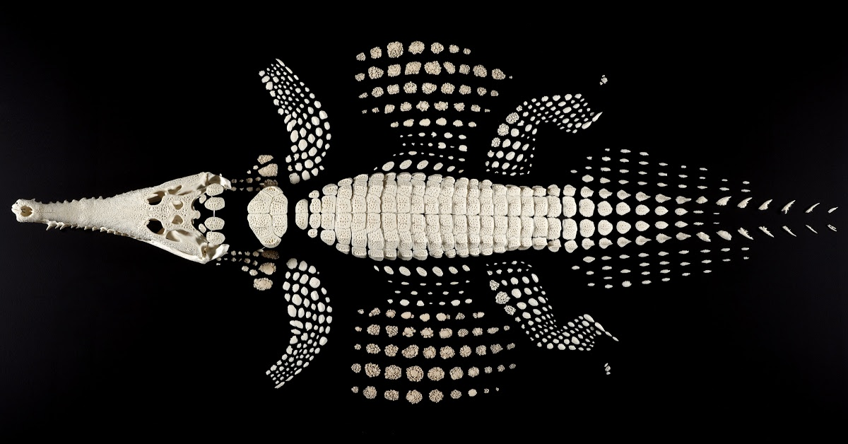
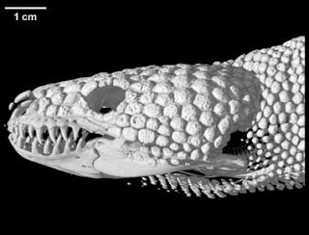
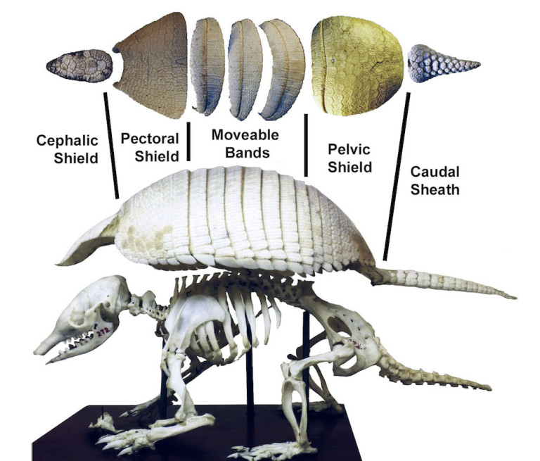
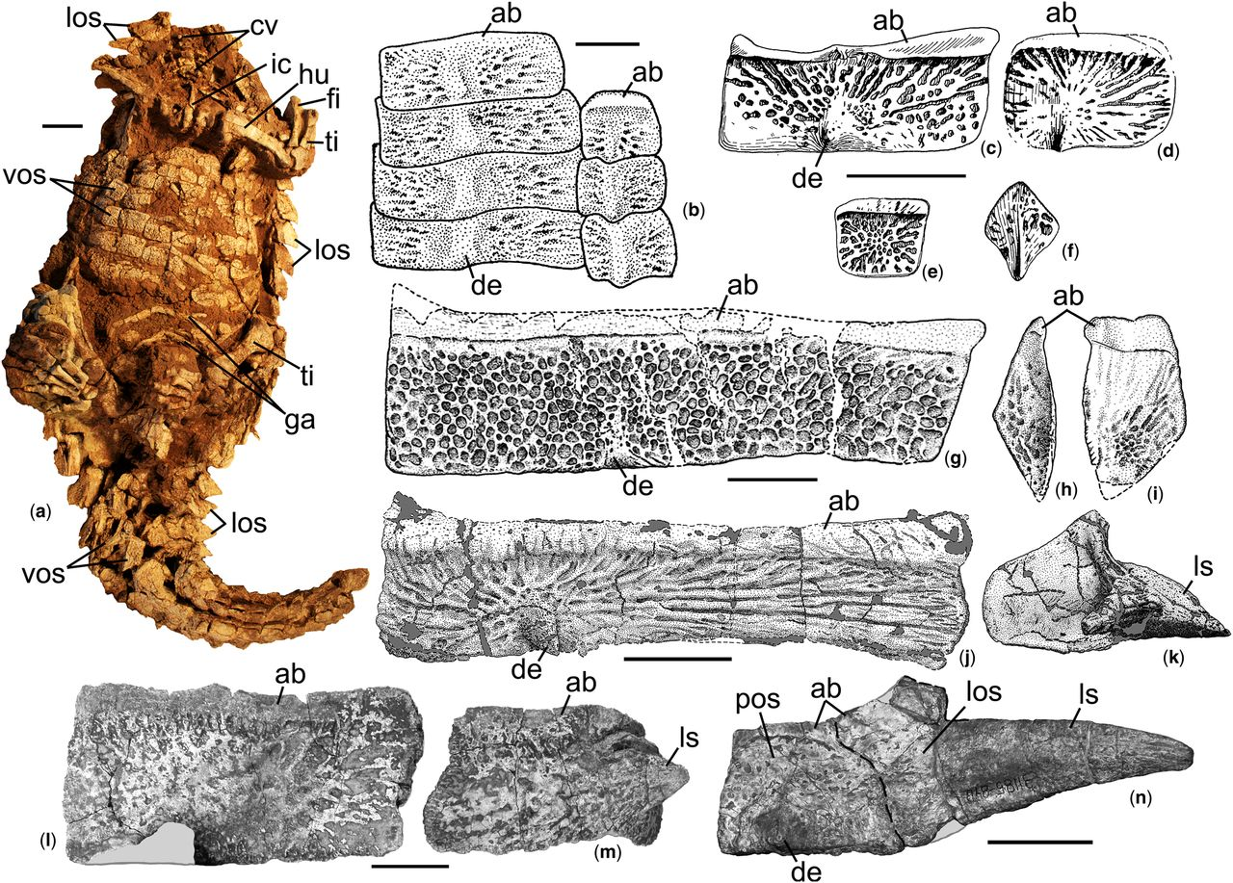
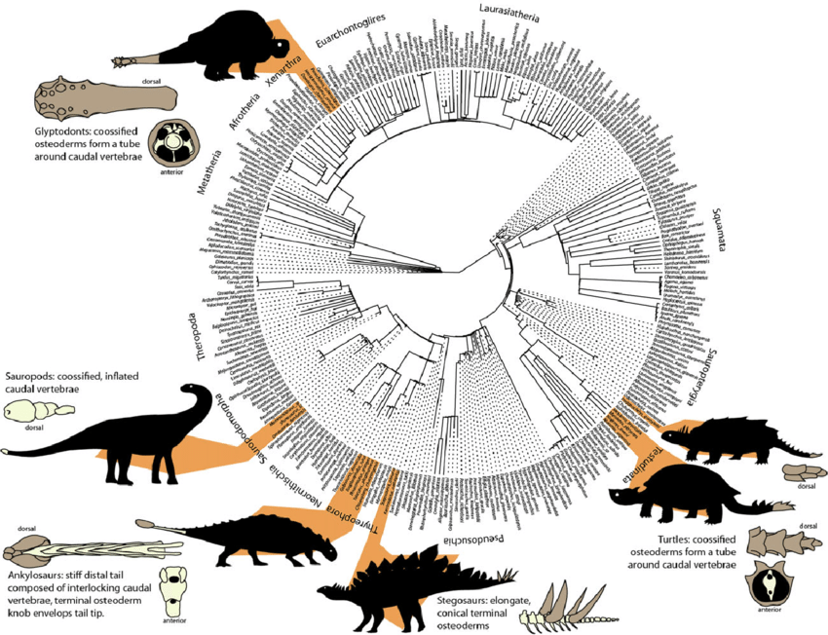
Osteoderms

Slide 6
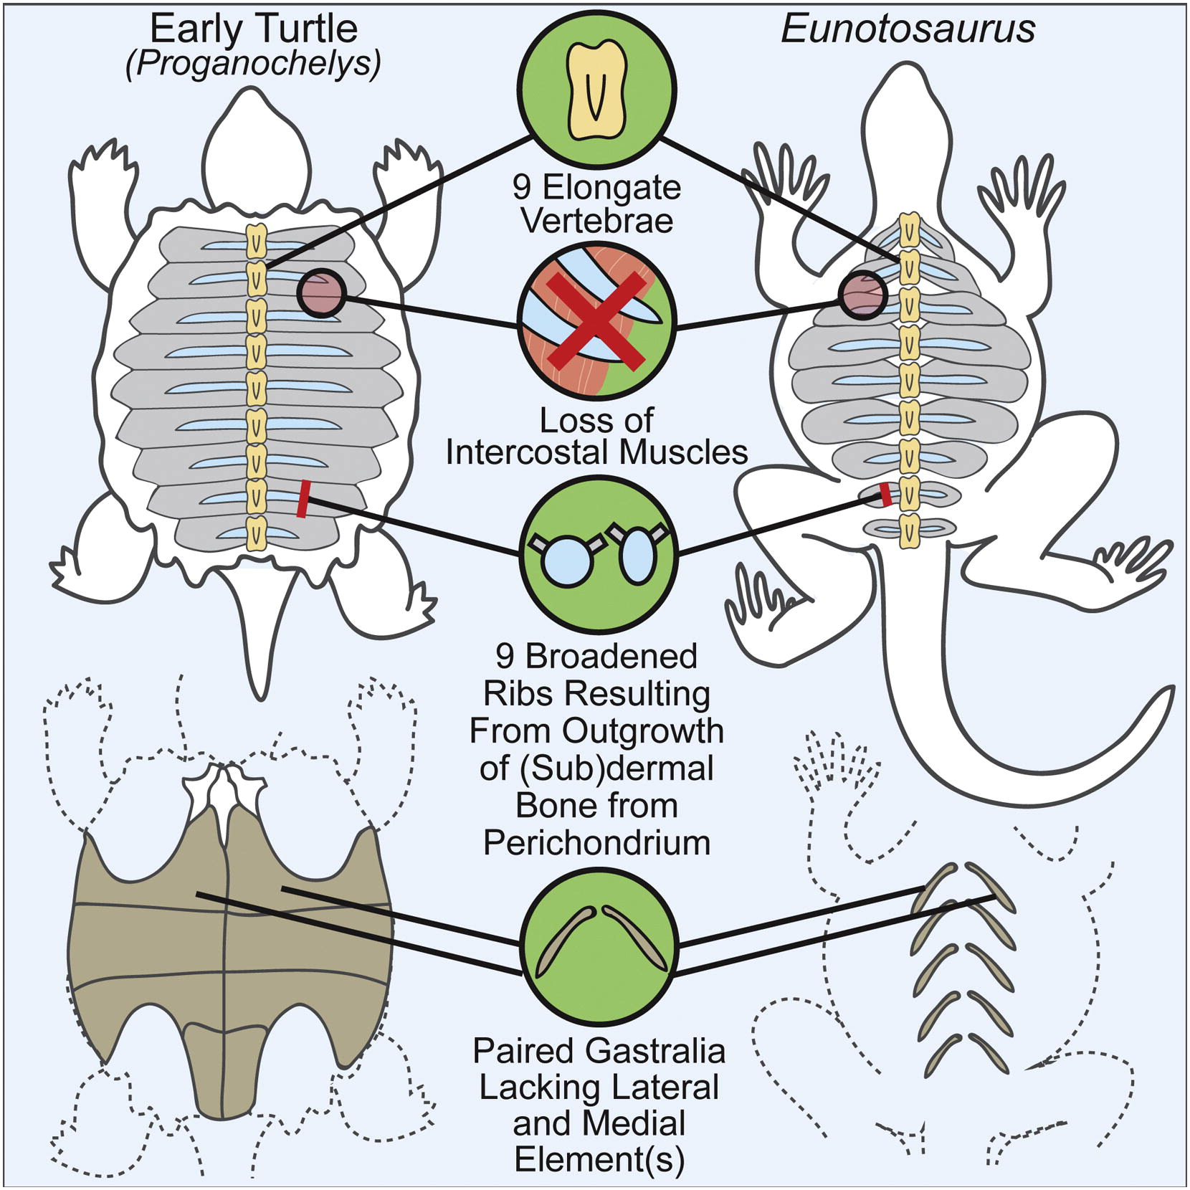
Testudines

Slide 7
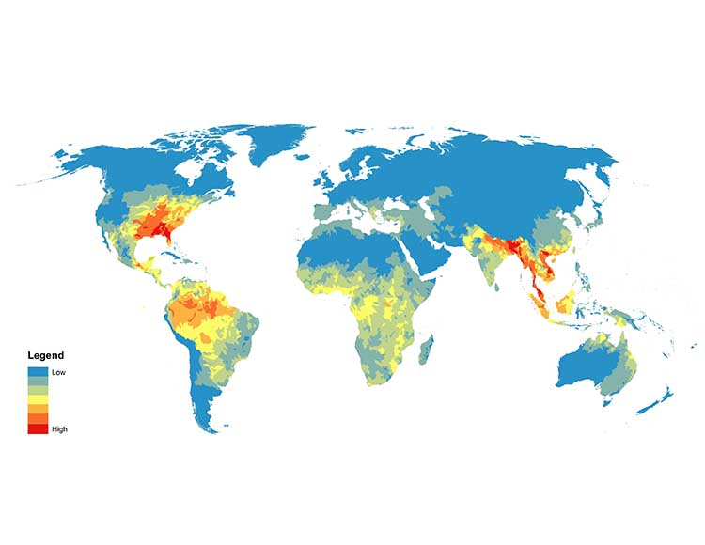
Testudines

Slide 8
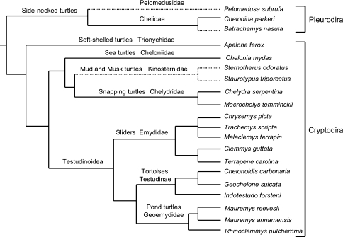
Testudines

Slide 9
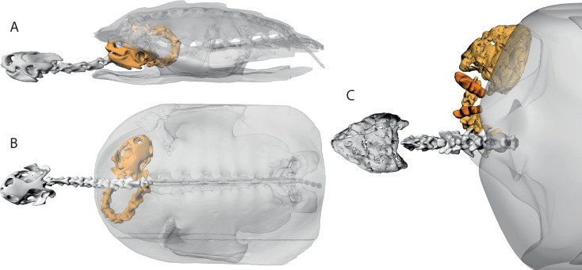
Testudines

Slide 10
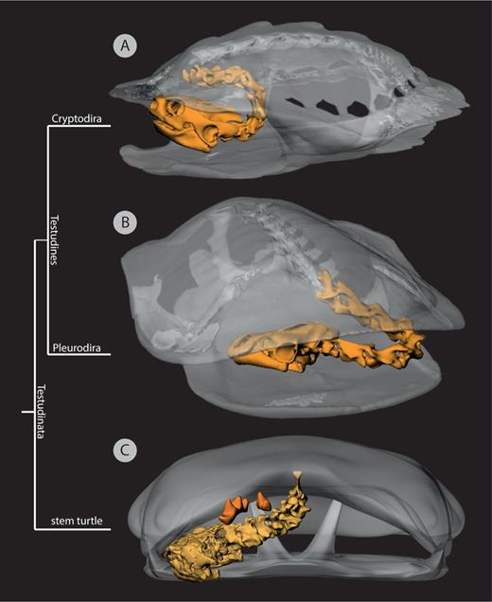
Testudines

Slide 11
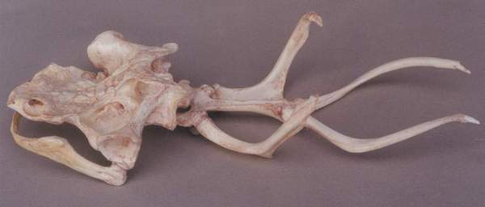
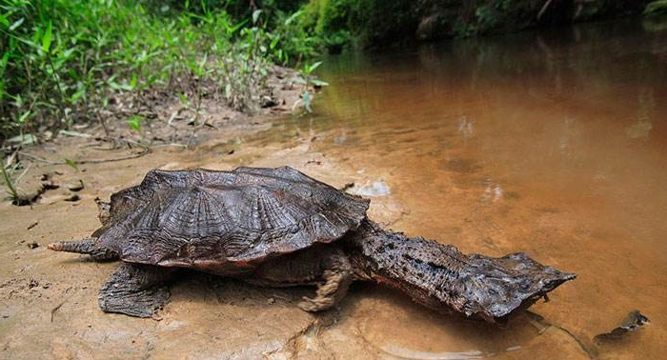
Testudines: Pleurodira

Slide 12
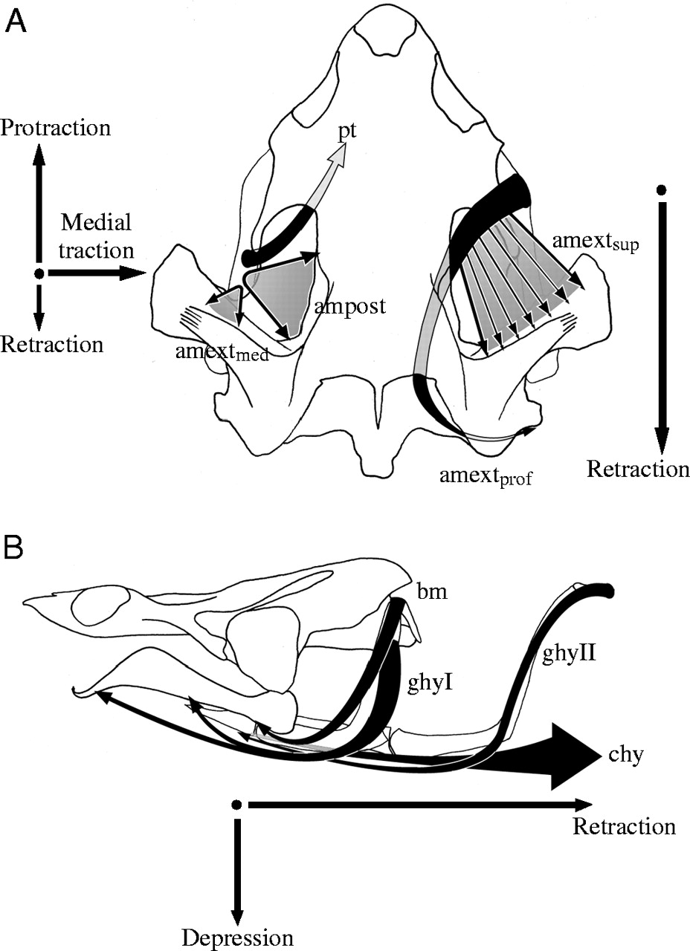
Testudines: Pleurodira

Slide 13
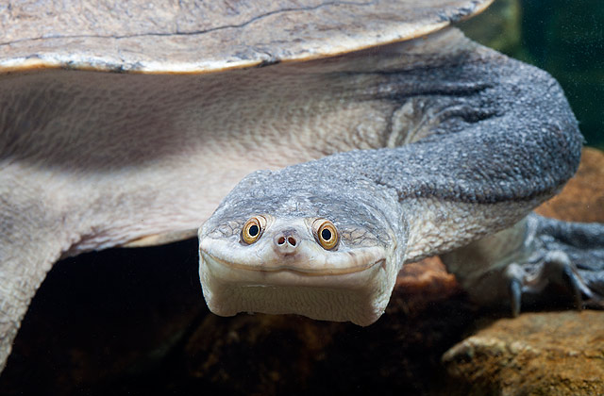
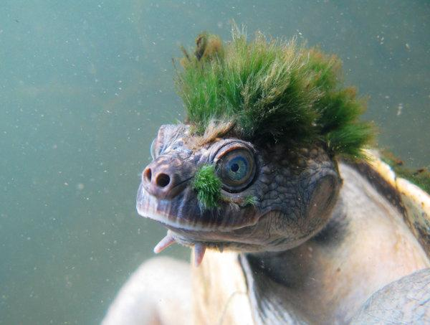
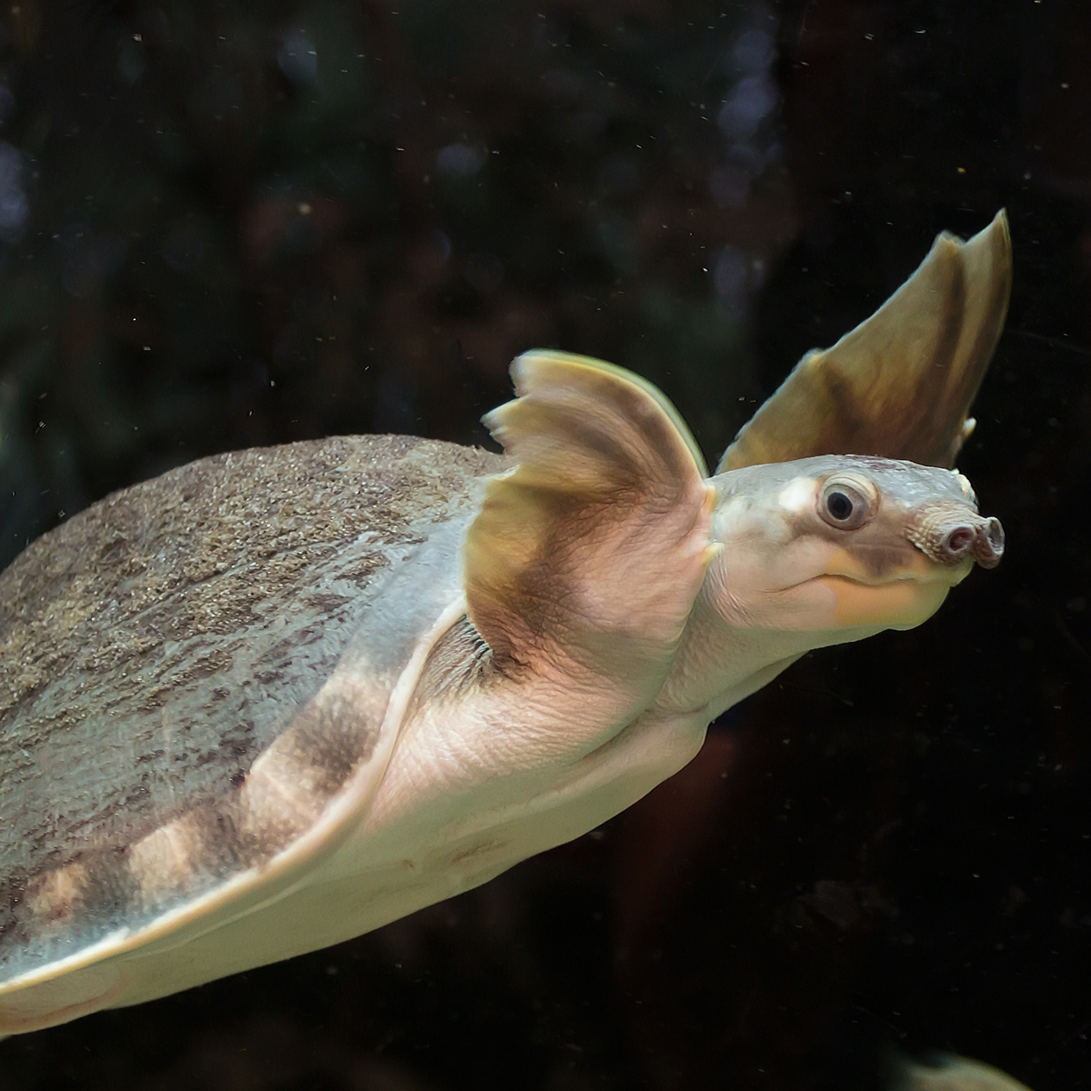
Testudines: Pleurodira

Slide 14
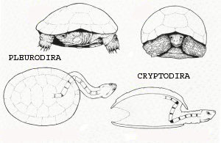
Testudines: Cryptodira

Slide 15
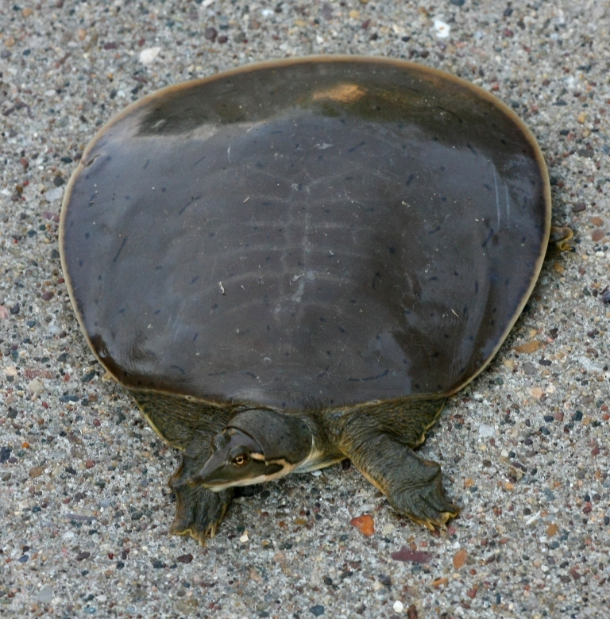
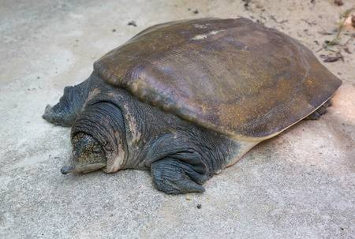
Testudines: Cryptodira: Trionychids

Slide 16
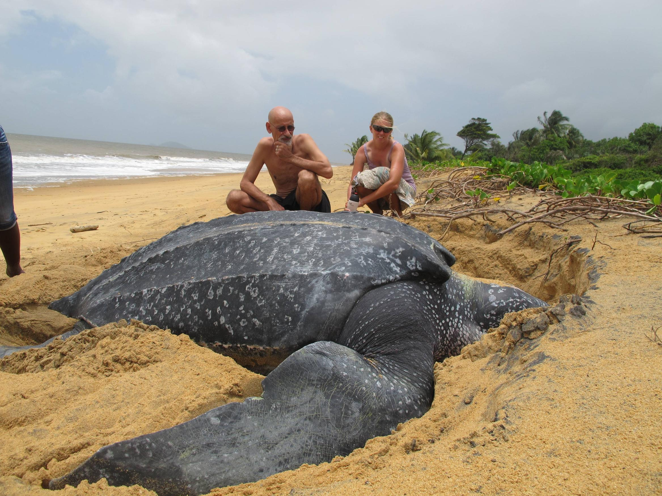
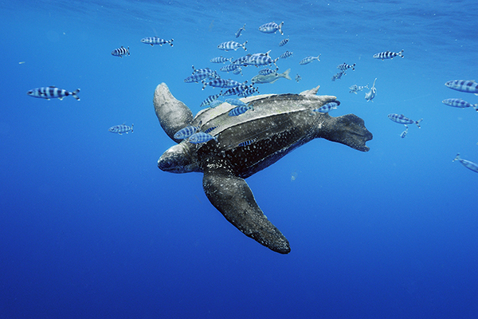
Testudines: Cryptodira: Chelonia

Slide 17
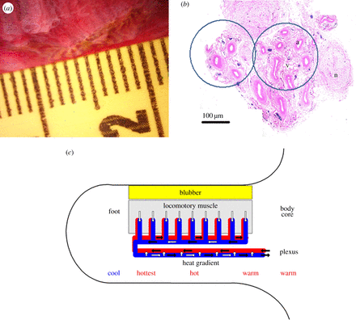
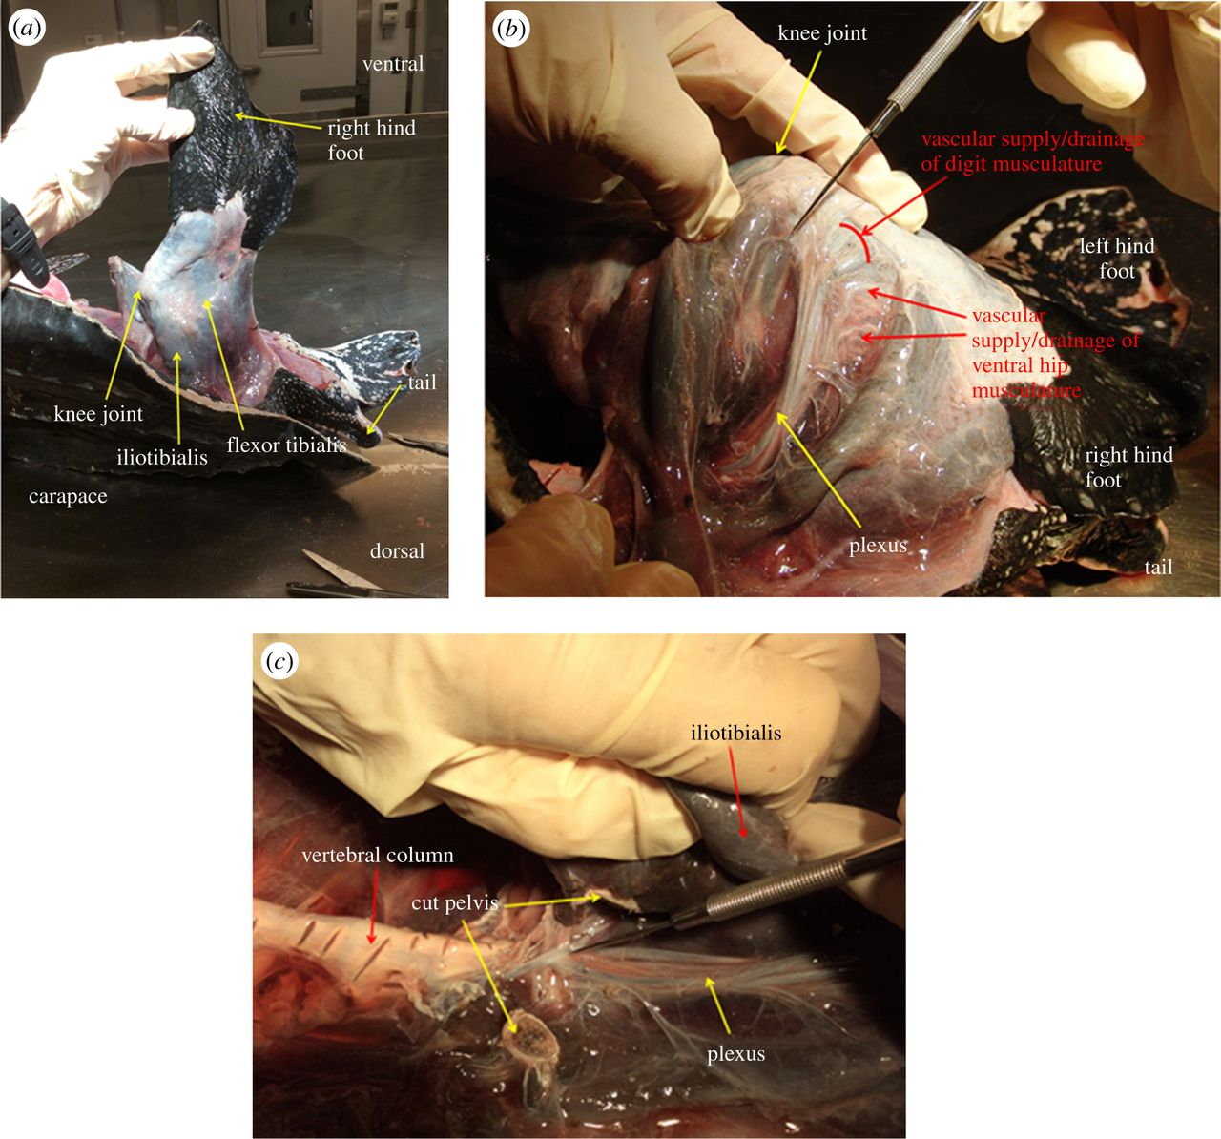
Testudines: Cryptodira: Chelonia

Slide 18
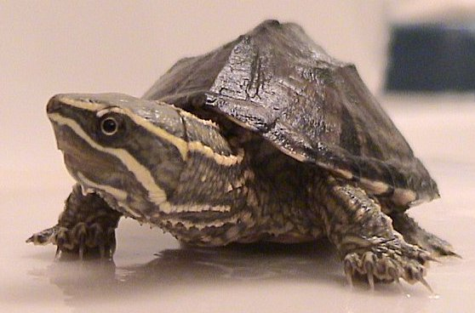
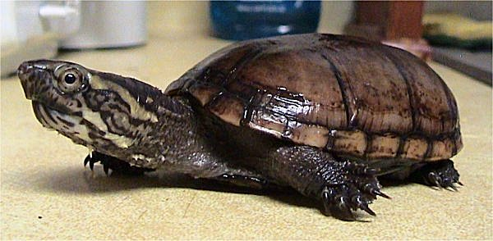
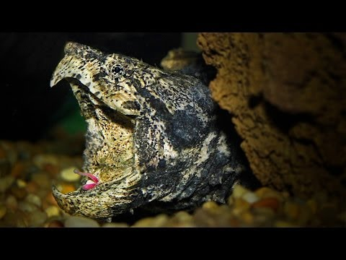
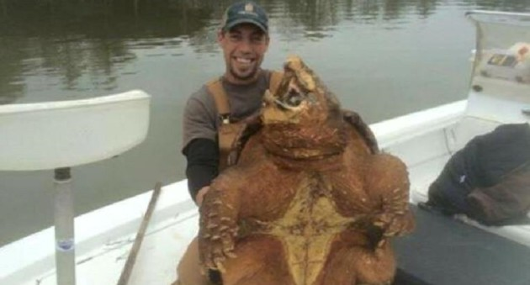
Testudines: Cryptodira: River & Mud & Snapping turtles

Slide 19
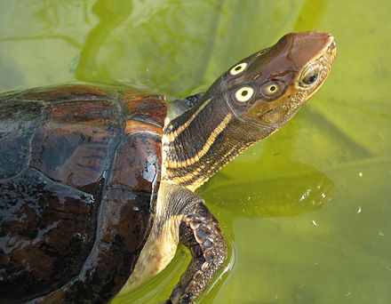
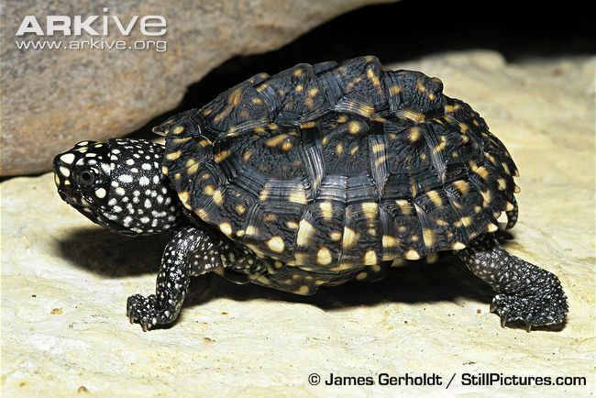
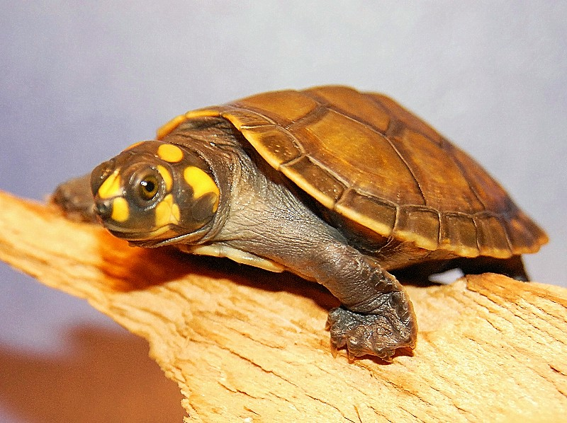
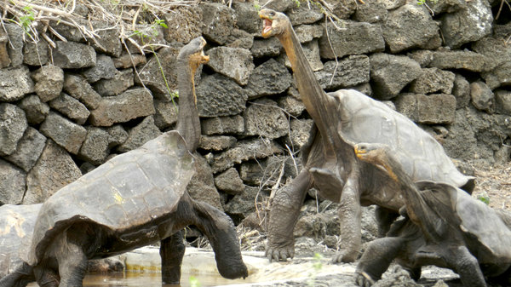
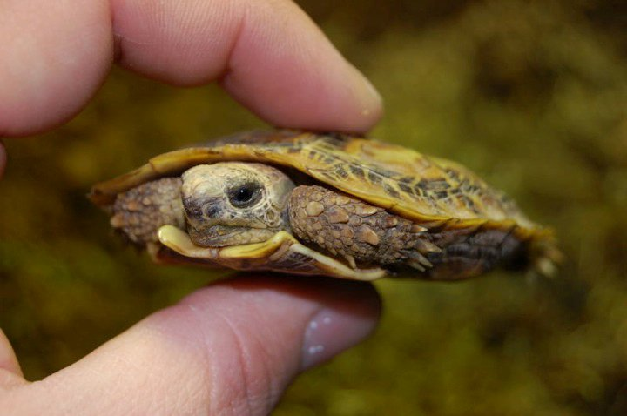
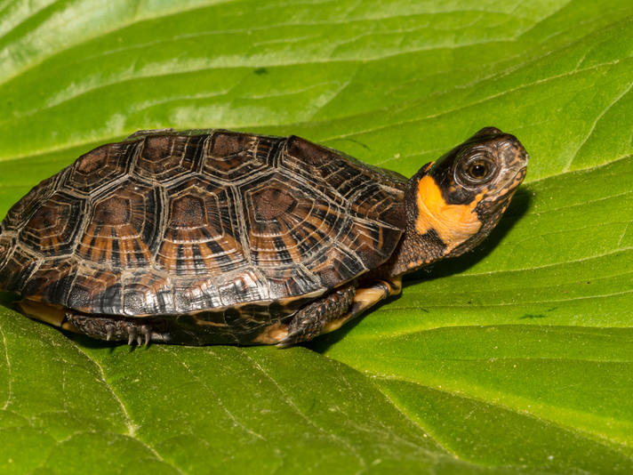
Testudines: Cryptodira: Testudinoidea

Slide 20
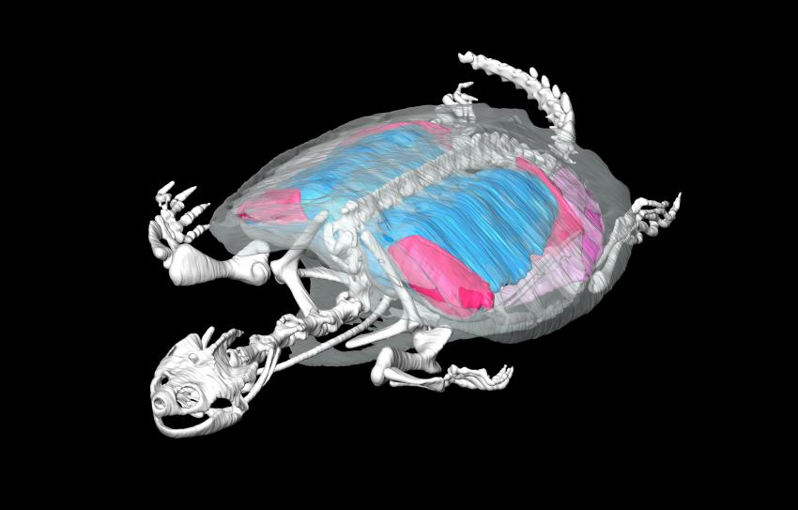
Breathing in a box
Notes:
A Computed Tomography rendering of a snapping turtle (Chelydra serpentina) showing the skeleton (white), lungs (blue), and abdominal muscles (red and pink) used to ventilate the lungs. Because turtles have locked their ribs up into the iconic turtle shell, they can no longer use their ribs to breathe as in most other animals and instead have developed a unique abdominal muscle based system. Read more at: https://phys.org/news/2014-11-turtles-muscle-power-due-rigid.html#jCp

Slide 21
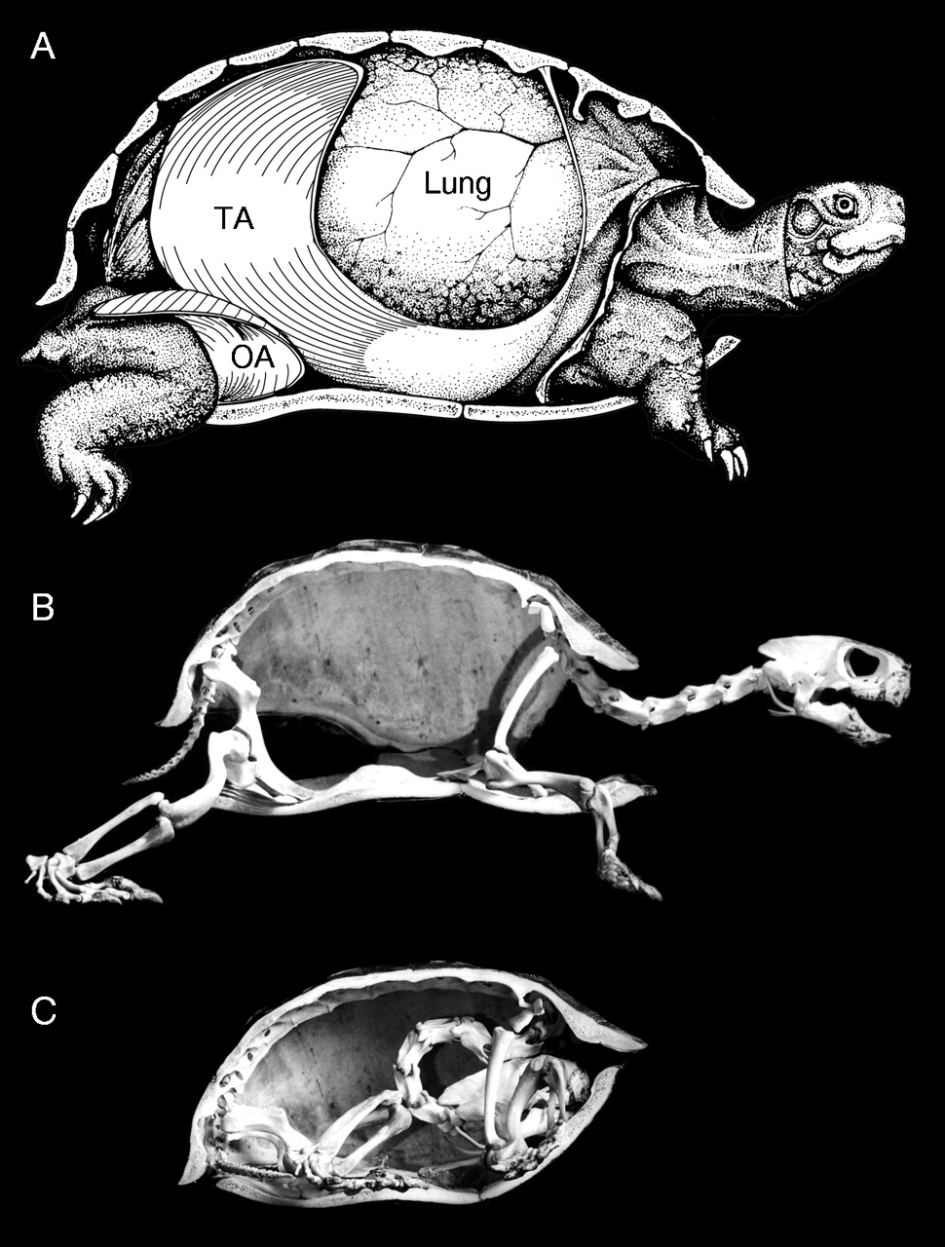
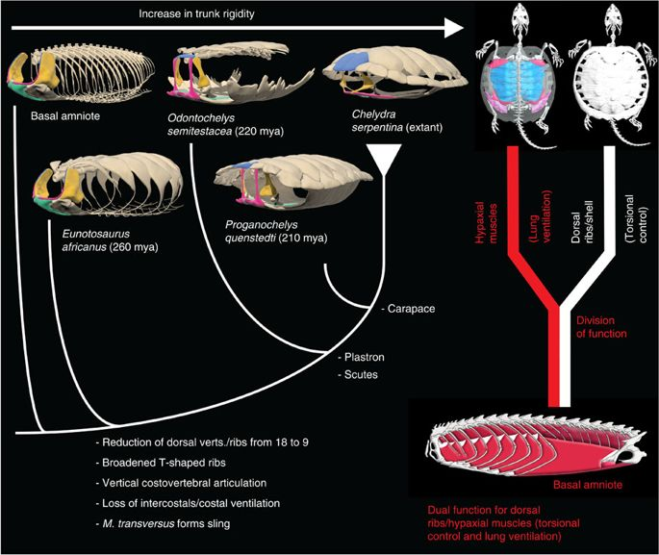
Notes:
http://jeb.biologists.org/content/206/19/3391
he transverse abdominis (TA) and oblique abdominis (OA) muscles alternate bilateral muscle activity to produce exhalation-inhalation breathing cycles in turtles at rest (McCutcheon, 1943; Gans and Hughes, 1967; Gaunt and Gans, 1969; Currie, 2001). These abdominal muscles are considered the primary ventilation mechanism of turtles because they are present in all extant turtle species (George and Shaw, 1959; Shaw, 1962) and have been found to be active consistently during lung ventilation (Gans and Hughes, 1967; Gaunt and Gans, 1969). The OA is a paired, thin, cup-shaped muscle attaching along the rear carapacial and plastral margins in the inguinal limb pockets, anterior to each hindlimb and just deep to the skin (Fig. 1A). At rest, this muscle curves into the body cavity; when contracted, it flattens to move the flank postero-ventero-laterally, which reduces intrapulmonary pressure and produces inhalation when the glottis is open

Slide 22
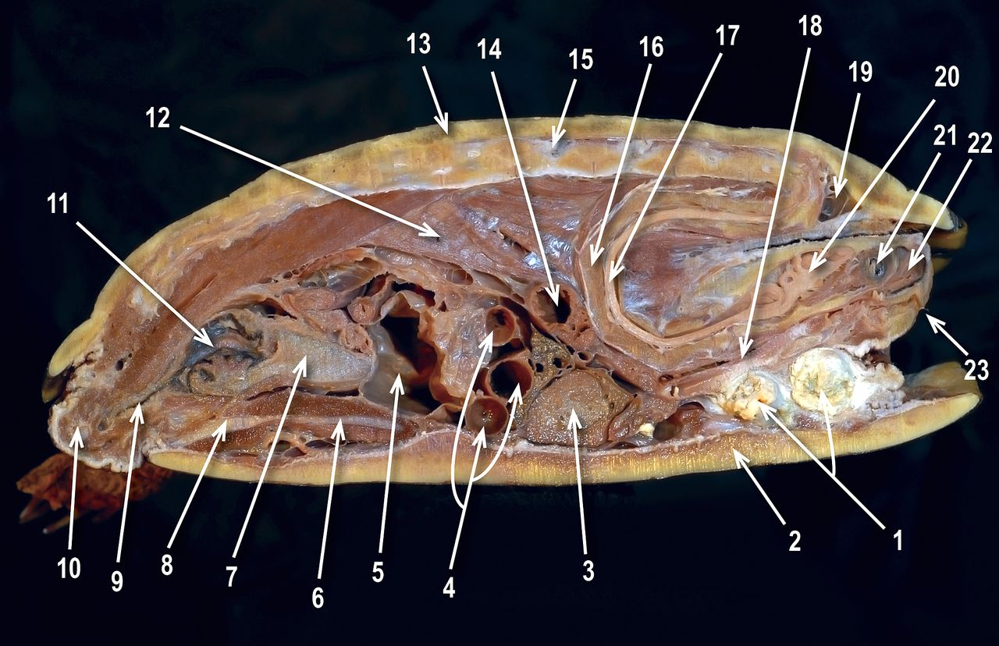
Notes:
http://jeb.biologists.org/content/206/19/3391
he transverse abdominis (TA) and oblique abdominis (OA) muscles alternate bilateral muscle activity to produce exhalation-inhalation breathing cycles in turtles at rest (McCutcheon, 1943; Gans and Hughes, 1967; Gaunt and Gans, 1969; Currie, 2001). These abdominal muscles are considered the primary ventilation mechanism of turtles because they are present in all extant turtle species (George and Shaw, 1959; Shaw, 1962) and have been found to be active consistently during lung ventilation (Gans and Hughes, 1967; Gaunt and Gans, 1969). The OA is a paired, thin, cup-shaped muscle attaching along the rear carapacial and plastral margins in the inguinal limb pockets, anterior to each hindlimb and just deep to the skin (Fig. 1A). At rest, this muscle curves into the body cavity; when contracted, it flattens to move the flank postero-ventero-laterally, which reduces intrapulmonary pressure and produces inhalation when the glottis is open

Slide 23
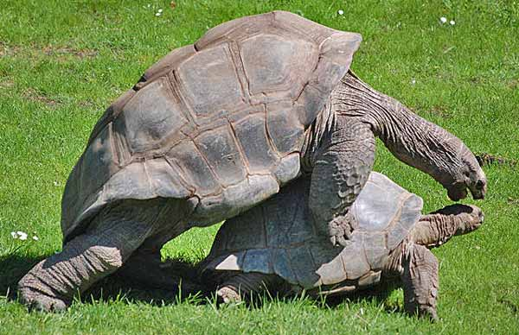
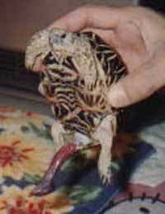
Turtle mating
Notes:
Intromittent organ inflated via blood

Slide 24
